Slide 1

Presentation for M.SC Dissertation 2024-25
on
Numerical Modelling of Hailstorm Events Over Eastern India: Role of Microphysics and Orographic lifting
Presented
By
S. Narayanaswamy
(423AS2039)
​
Under the supervision
of
Prof. Krishna Kishore Osuri ​
DEPARTMENT OF EARTH AND ATMOSPHERIC SCIENCES
NATIONAL INSTITUTE OF TECHNOLOGY, ROURKELA.
ODISHA – 769008

Slide 2
Contents
Introduction
Gaps in existing Research
Objectives
Data Methodology
Results and Discussion
Conclusion
References

Slide 3
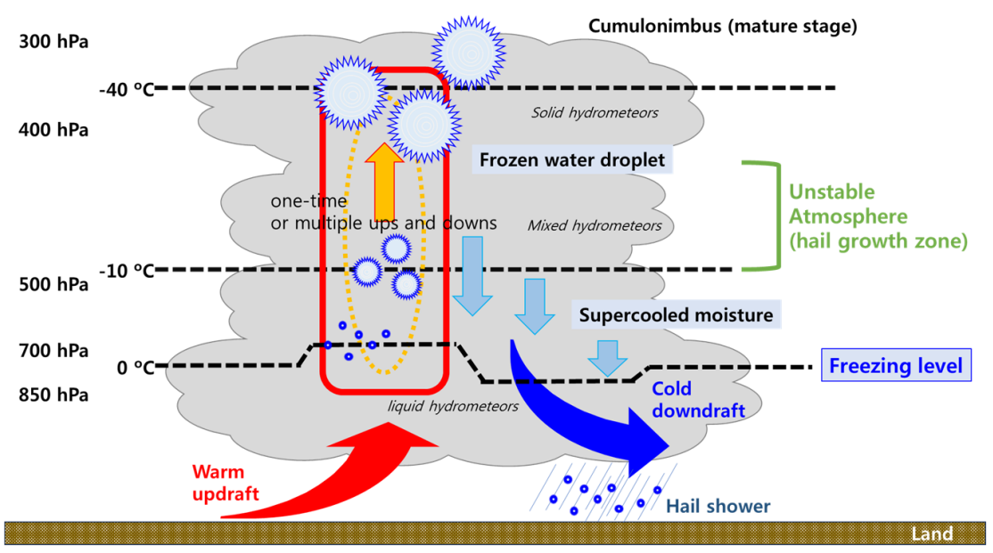
1.Introduction
A thunderstorm is a short-lived but intense convective weather phenomenon, characterized by heavy rainfall, thunder, lightning, strong gusty winds, and occasionally tornadoes or hail (Tyagi 2007; Tyagi et al., 2011; Osuri et al., 2017).
In severe convective storms, strong updrafts lift raindrops into the freezing temperatures within a storm cloud, forming hail (Browning et al., 1976).
In severe thunderstorms
Strong surface heating
Warm/ Moist air updrafts
Latent Heat release
Super Cooled Water
Repeated Cycles
Accretion/ Aggregation
Terminal Velocity
Fig A simplified schematic of hail formation and growth at a mature stage of cumulonimbus clouds. Source: Kim et al., 2023

Slide 4
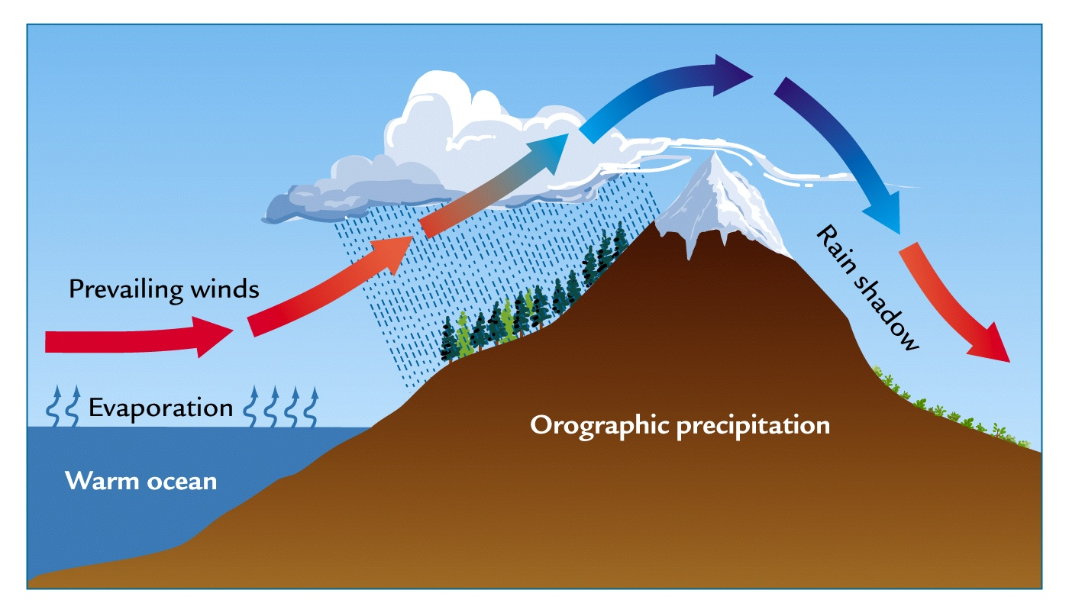
Thunderstorms are not solely formed by convective processes, Thunderstorm can also be triggered by various mechanisms (Wilson et al., 1997) such as
These droplets freeze onto ice nuclei, graupel, or smaller hailstones (Allen et al., 2020), enabling them to grow larger as they are carried repeatedly through the storm's strong updrafts.
orographic lifting
frontal lifting, and convergence lifting
Fig.2 Schematic diagram for orographic lifting topographic flow wind to lift upward (source: https://www2.hawaii.edu/~dennis/GeoBook/chapter_6/lift_oro.jpg)

Slide 5
2. Gaps in existing Research
There is a limited studies in addressing the hail prediction, especially over the eastern parts of India using numerical modelling.
Sensitivity of cloud microphysics is crucial for understanding the hailstorm mechanism.
Lack of understanding the hail formation mechanism between high and low elevated / inland and coastal regions.
3. Objectives
Evaluating the sensitivity of different microphysics parameterization on hailstorm simulation.
Analysing the convective behaviour of hailstorms by using Skew-T Log-P thermodynamic diagrams.
Segregating different triggering mechanisms for the development of the hailstorm

Slide 6
4.Data and Methodology
In this study, two hailstorm cases over the eastern Indian region are analysed. The selected cases occurred on 21 April 2019 over Balasore (case 1) and 3 March 2020 over Ranchi (case 2).
These hailstorm events were simulated using the Weather Research and Forecasting (WRF) model for five MP- schemes namely Ferrier, Wsm6, Thompson, Milbrandt, and Morrison.
The model configuration was employed from Priya et al. (2021)
Table 1. Description of details:
Model | WRF Version 3.4
Map projection | Mercator
Horizontal resolution | Nest: Outer (6 km) and inner (2 km)
Hailstorm case simulation | 00:00 UTC April 21 TO 24:00 UTC 21 April 2019 (case 1) and 00:00 UTC march 03 TO 24:00 UTC 03 march 2020 (case 2)
Horizontal grid scheme | Arakawa C-grid
Microphysics Schemes | Eta (Ferrier), Milbrandt 2-mom(with hail and graupel option), Thompson, Morrison 2-mom and Wsm6
Land surface model | Noah (Tewari 2004)
Surface layer model | MM5 (Jiménez et al., 2012)
Planetary boundary layer | YSU scheme (Hong et al., 2006)
Cumulus parameterization | Kain-Fritsch (Kain 2004) (For outer domain)
Radiation scheme | Shortwave ~ Dudhia scheme; Longwave ~ RRTM scheme (Iacono et al., 2008)

Slide 7
Data used in the study
Hailstorm observation records were obtained from STORM reports, indicating a maximum hail diameter of 9 mm at 09:00 UTC for the Balasore event and 10 mm at 08:00 UTC for the Ranchi event.
In this study, the Weather Research and Forecasting (WRF) model was configured with a high spatial resolution of approximately 2 km and temporal resolution of 30 minutes. Model outputs are used in the study.
The Global Precipitation Measurement (GPM) mission provided spatial resolution of ~0.1° × 0.1° and a temporal resolution of 30 minutes over the domain 15°–25°N and 80°–90°E is used.
In this study, 2-meter temperature (°C) and 2-meter relative humidity (%) METAR data from the Ranchi station are used.

Slide 8
5.Results and Discussion
(a) Evaluating the sensitivity of different microphysics parameterization on hailstorm simulation.
Fig. Temporal evaluation of various atmospheric parameters of (case 1)

Slide 9
Fig. Temporal evaluation of various atmospheric parameters of case 2
In this case weak 2m Temperature, 2m Relative Humidity, but PBL raised higher altitude

Slide 10
Various microphysic's Spatial distribution of accumulated rainfall of case 1

Slide 11
Various microphysic's Spatial distribution of accumulated rainfall of case 2

Slide 12
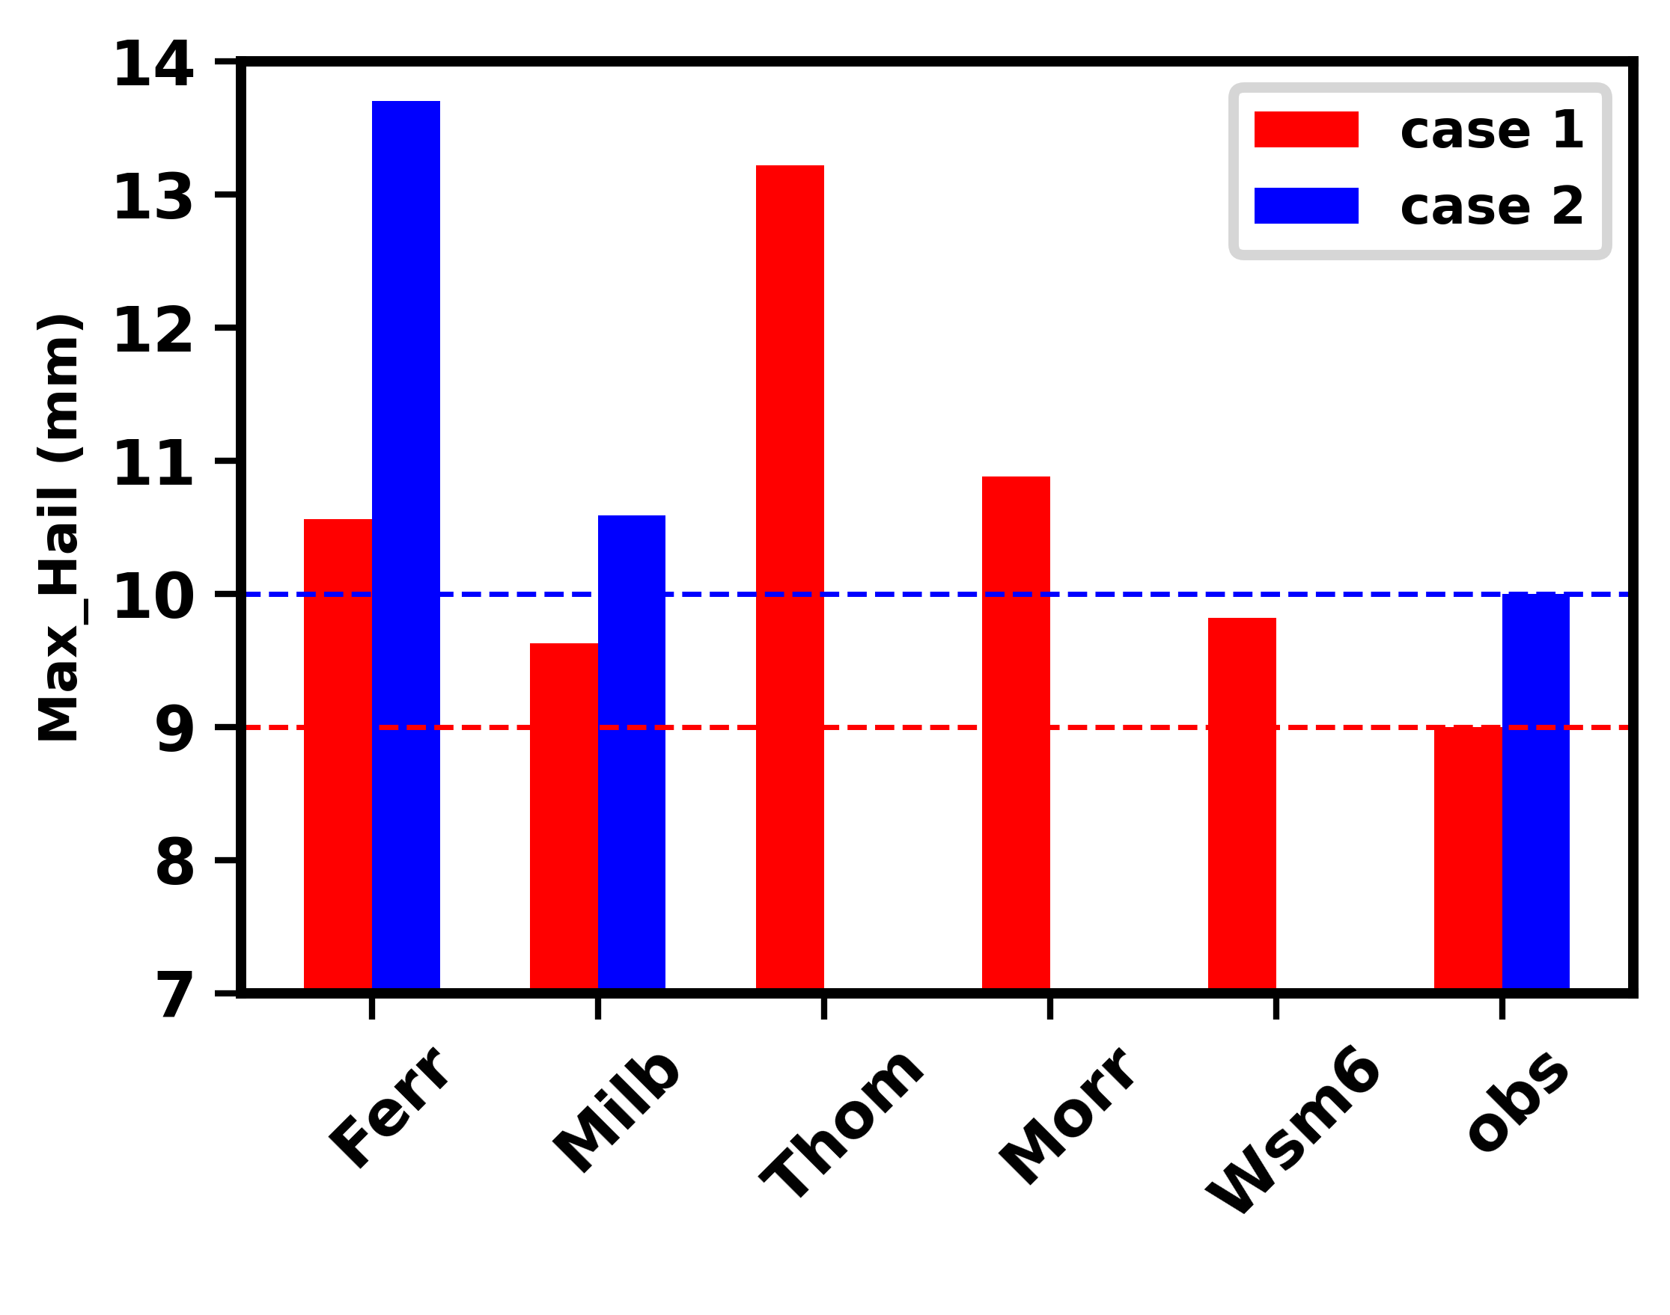
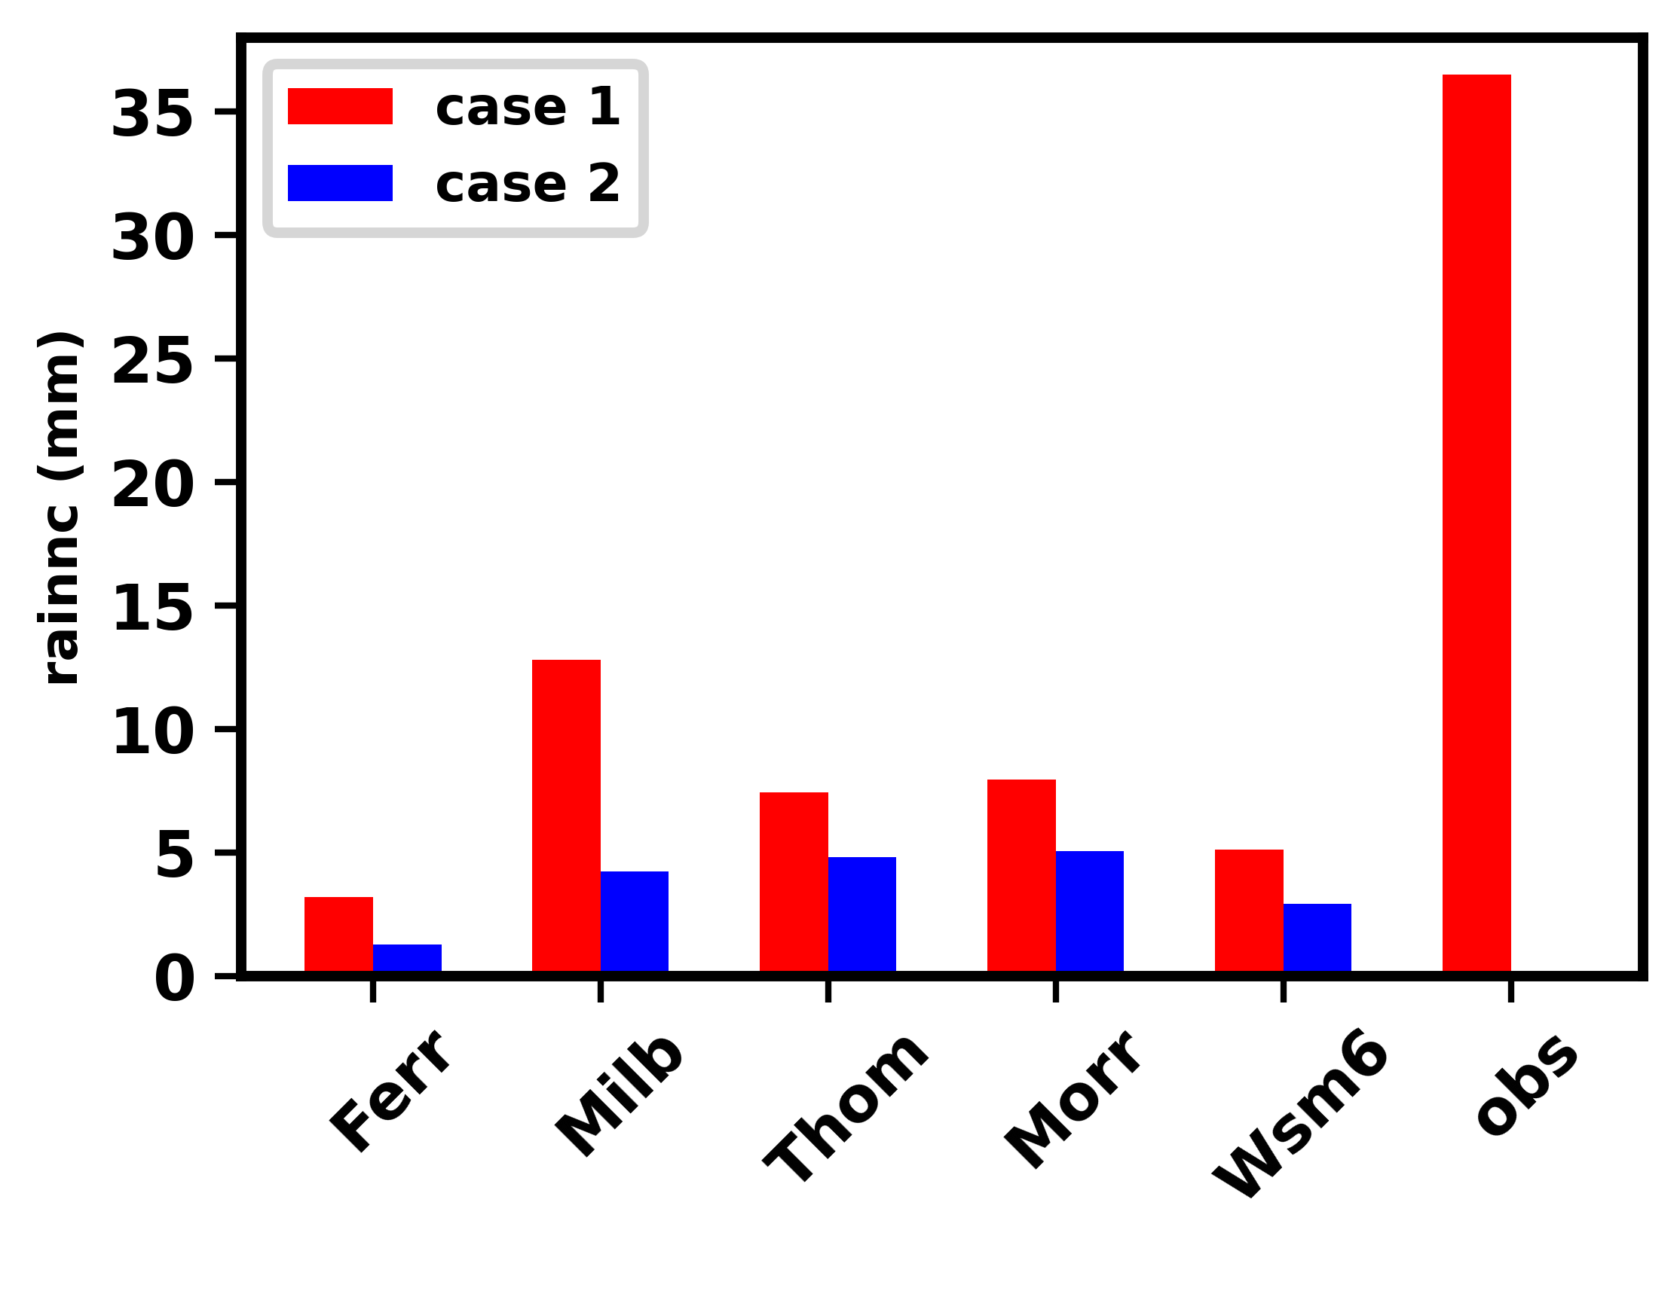
Inter comparison of Hailmaxd for different Microphysics experiments against the observation
Milbrandt relatively better performed with Observation
Comparison of Accumulated rainfall relation with Hailmaxd
Ferrier Scheme Strong correlation
Maximum rainfall in Milbrandt scheme

Slide 13
Vertical Distribution during thunderstorm activity of case 1
Strong vertical velocities in Ferrier, Thompson and Morrison
Moisture availability in Thunderstorm region.
Uniform potential temperature in all schemes
Fig. Vertical velocity: (shaded : m/s), 2. Potential Temperature (black Contour : °c), 3. Water vapor Mixing ratio 10⁻³ (blue Contour : g/kg ) of case 1

Slide 14
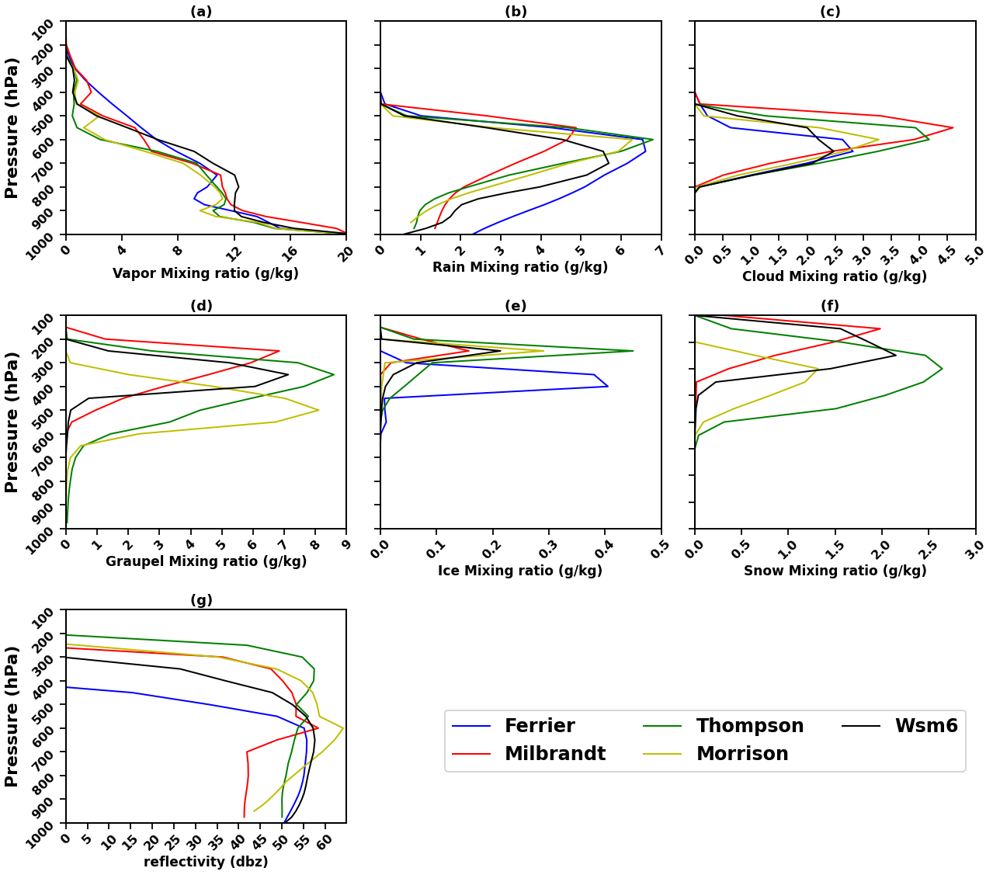
Hydrometeor distribution for case 1
Minimal variations are observed with in the schemes
Ice particles extended upto upper troposphere
This typical range of reflectivity (50–55 dBZ) appeared at 600-400 hpa height, that reflectivity indicates 1–2 cm of hail diameter.

Slide 15
Vertical Distribution during thunderstorm activity case2
Fig. Vertical velocity: (shaded : m/s), 2. Potential Temperature (black Contour : °c), 3. Water vapor Mixing ratio 10⁻³ (blue Contour : g/kg ) of case 2
Weak vertical velocity in Thompson

Slide 16
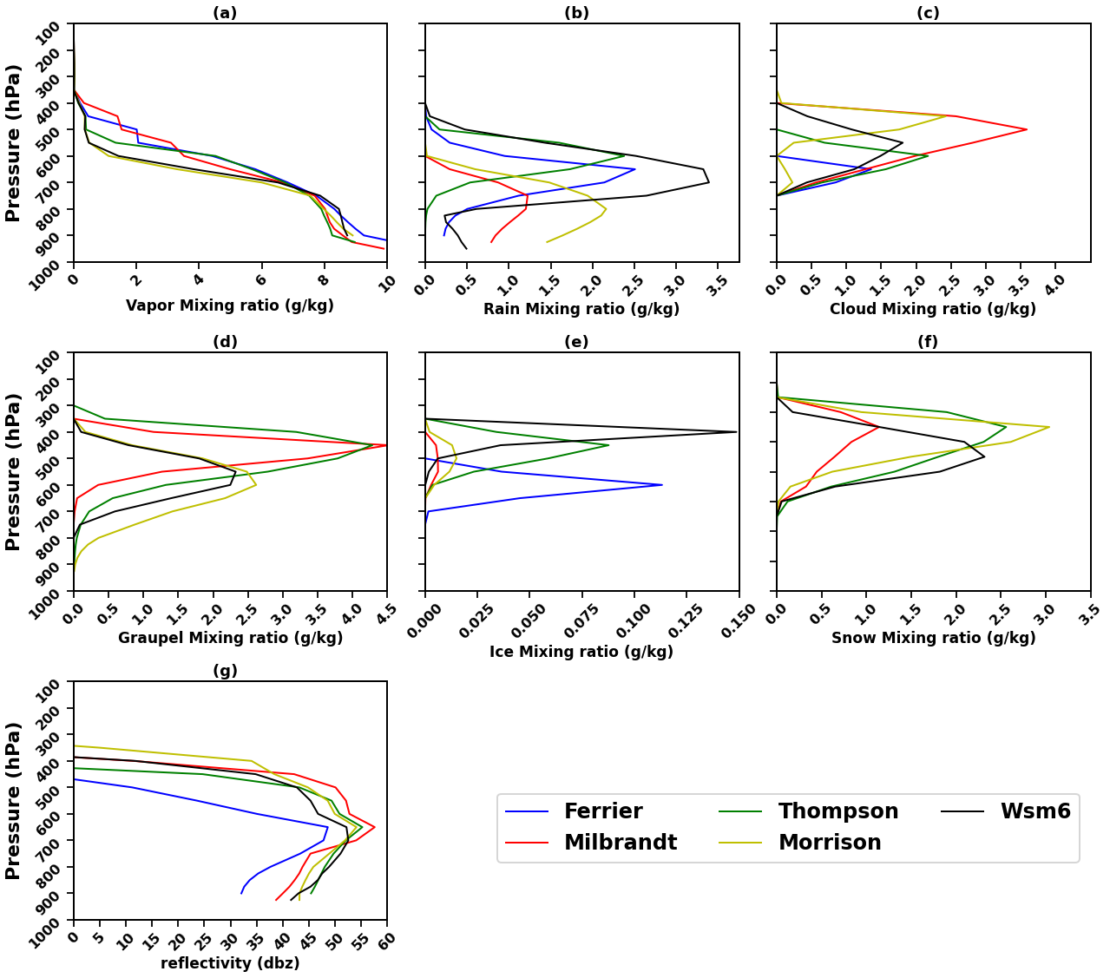
Hydrometeor distribution for case 2
Ice particles presented in Mid-troposphere
This reflectivity (50–55 dBZ) appeared at 700-600 hpa height, that reflectivity indicates approximate of 1–2 cm hail diameter.

Slide 17
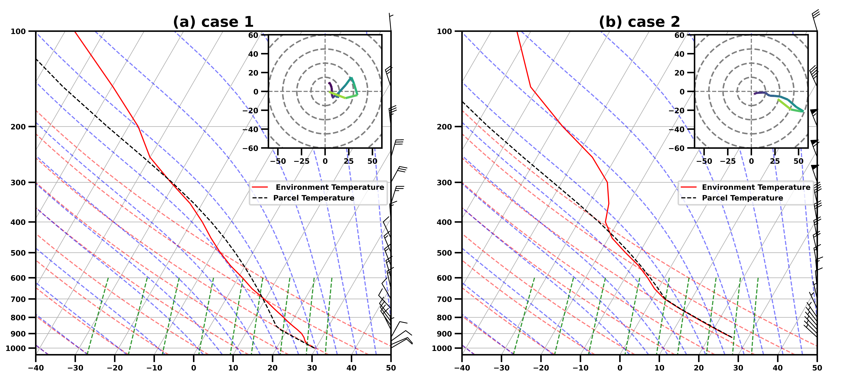
(b) Analysing the convective behaviour of hailstorms by using Skew-T
Log-P diagrams.
Skew-T, Log-P Thermodynamic soundings assessment of Atmosphere.
Fig Skew-T and Log-P Thermodynamic soundings parameters including surface based mixed-layer CAPE, CIN and bulk vertical wind shear, hodograph of wind trajectory in the vertical profile. The red, dotted black and green color lines representing the environmental temperature, air parcel temperature and atmospheric stability. This data used by WRF model Milbrandt micro physics scheme(Pounds et al., 2024).
Effective CAPE and CIN values are absent in case 2 and it's indicating neutrally stable atmosphere in lower altitude. In this case2 atmosphere indicating low convection.

Slide 18
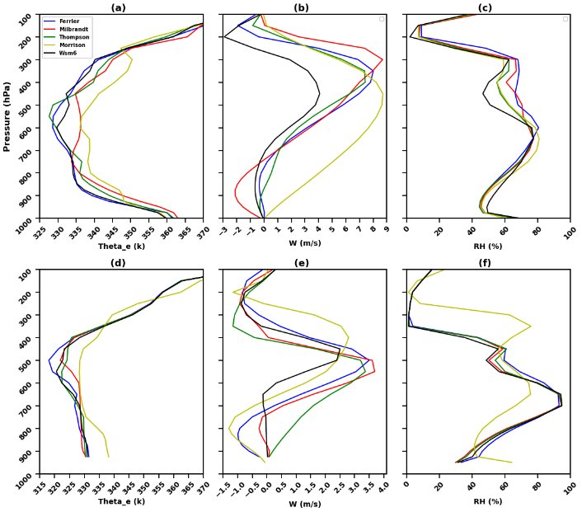
Vertical evaluation of key variables responsible for triggering hailstorm development.
Strong Equivalent potential temperature in case 1 (potential convection)
Neutrally stable atmosphere in case 2
Mid-troposphere dry atmosphere in case-1 and moist atmosphere in case-2

Slide 19
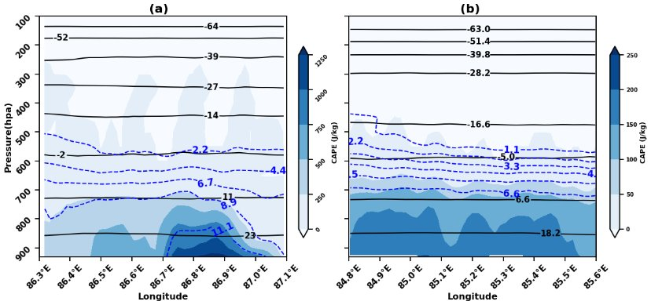
Vertical evaluation of key atmospheric factors responsible for triggering hailstorm development.
Assessment of thunderstorm instability using CAPE, Temperature and Specific Humidity.
Strong Equivalent potential temperature in case 1 (potential convection)
Neutrally stable atmosphere in case 2
Mid-troposphere dry atmosphere in case 1 and moist atmosphere in case 2
Strong CAPE in case 1 and weak cape in case 2
Atmosphere contact with Earth in case 1 and moisture deficit in case 2
Fig Longitude and Pressure cross section of (1) CAPE (shaded : J/kg), (2) Temperature (black contour : °C), (3) Specific Humidity (blue contour : g/kg) from Milbrandt Scheme

Slide 20
Case-2 (Ranchi region) has low CAPE and weakly unstable atmosphere compared to case-1, but Hailstorm is formed. How?

Slide 21
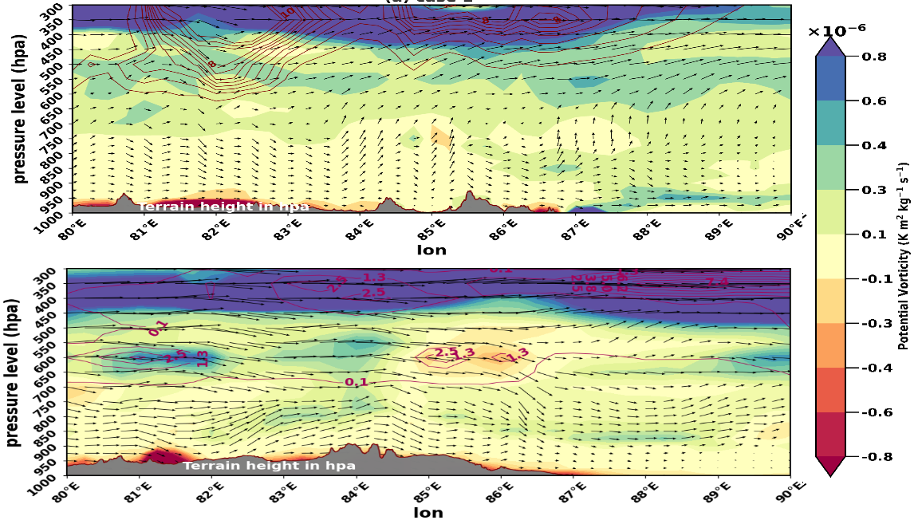
(c) Segregating different triggering mechanisms for the development of the hailstorm
Assessment of Orographic influence over undulating terrain
(a) case 1
(b) case 2
Fig. longitudinal vertical cross section of 1. Potential vorticity(shaded : m*2/s k/kg) 10⁻⁶, 2. Vertical wind direction(vector : m/s), 3. Ice & Snow mixing ratio(pink : g/kg) 10^-5 and 4. Terrain height (shaded : grey : hpa). Data used from Milbrandt Scheme during the thunderstorm time for both the cases (Tsai et al., 2018; Rajeswari et al., 2021).
Potential vorticity supporting for hail growth in case 2 at Ranchi (23.3° N 85.2° E)
Mid-tropospheric Ice formation in case 2

Slide 22
6.Conclusion
To evaluate the sensitivity of microphysics parameterizations in simulating hailstorms, two distinct cases over Ranchi and Balasore were simulated using the WRF model initialized at 00 UTC. The Milbrandt scheme most accurately simulated hail size (~10 mm) in both cases compared to other schemes. All schemes showed thunderstorm features with a drop in 2m temperature and rise in relative humidity post-storm initiation. Milbrandt produced larger hail growth at higher altitudes (400–200 hPa in Case 1 and 600–400 hPa in Case 2), showing favorable conditions for hail formation. Vertical velocity analysis showed stronger updrafts in Ferrier, Thompson, and Morrison schemes for Case 1; Morrison and WSM6 were stronger in Case 2. Case 1 had stronger vertical instability and dry air at 600 hPa, while Case 2 was more neutrally stable with less vertical gradient in equivalent potential temperature. Case 1 showed higher CAPE (~1100 J/kg) and surface moisture support. In Case 2, moisture was mainly confined to the mid-troposphere. Skew-T diagrams indicated an unstable atmosphere in Case 1 and a near-neutrally stable profile in Case 2. Hodographs showed strong vertical wind shear in Case 2. In Ranchi, orographic lifting significantly contributed to hail development, but coastal Balasore region developed by the convective process.

Slide 23
7.References
Tyagi, A., 2007. Thunderstorm climatology over Indian region. Mausam, 58(2), pp.189-212.
Tyagi, B., Naresh Krishna, V. and Satyanarayana, A.N.V., 2011. Study of thermodynamic indices in forecasting pre-monsoon thunderstorms over Kolkata during STORM pilot phase 2006–2008. Natural hazards, 56, pp.681-698.
Pawar, S.D., Gopalakrishnan, V., Murugavel, P., Sinkevich, A. and Lal, D.M., 2014. Effects of environmental conditions on inducing charge structures of thunderstorms over Eastern India. Earth, Planets and Space, 66, pp.1-14.
Osuri, K.K., Nadimpalli, R., Mohanty, U.C., Chen, F., Rajeevan, M. and Niyogi, D., 2017. Improved prediction of severe thunderstorms over the Indian Monsoon region using high-resolution soil moisture and temperature initialization. Scientific Reports, 7(1), p.41377.
Kim, M.H., Lee, J. and Lee, S.J., 2023. Hail: Mechanisms, monitoring, forecasting, damages, financial compensation systems, and prevention. Atmosphere, 14(11), p.1642.
Easterling, D.R. and Robinson, P.J., 1985. The diurnal variation of thunderstorm activity in the United States. Journal of Applied Meteorology and Climatology, 24(10), pp.1048-1058.
Wilson, J.W. and Megenhardt, D.L., 1997. Thunderstorm initiation, organization, and lifetime associated with Florida boundary layer convergence lines. Monthly Weather Review, 125(7), pp.1507-1525.
Flores Rojas, J.L., Moya-Alvarez, A.S., Kumar, S., Martínez-Castro, D., Villalobos-Puma, E. and Silva-Vidal, Y., 2019. Analysis of possible triggering mechanisms of severe thunderstorms in the tropical central Andes of Peru, Mantaro Valley. Atmosphere, 10(6), p.301.

Slide 24
He, L., Long, L., Chen, B., Wang, Y., Geng, F. and Yan, X., 2021. A case study on the triggering mechanisms of localized warm-sector rainstorm. Meteorology and Atmospheric Physics, 133, pp.1707-1717.
Bhavyasree, Panda, S.K., Wasson, G., Mondal, U., Kumar, A. and Sharma, D., 2024. Assessing the performance of WRF model in simulating severe hailstorm events over Assam and Bihar, India. Modeling Earth Systems and Environment, 10(5), pp.6013-6034.
Malečić, B., Prtenjak, M.T., Horvath, K., Jelić, D., Jurković, P.M., Ćorko, K. and Mahović, N.S., 2022. Performance of HAILCAST and the Lightning Potential Index in simulating hailstorms in Croatia in a mesoscale model–Sensitivity to the PBL and microphysics parameterization schemes. Atmospheric research, 272, p.106143.
Tsai, C.L., Kim, K., Liou, Y.C., Kim, J.H., Lee, Y. and Lee, G., 2022. Orographic‐Induced Strong Wind Associated With a Low‐Pressure System Under Clear‐Air Condition During ICE‐POP 2018. Journal of Geophysical Research: Atmospheres, 127(13), p.e2021JD036418.
Rajeswari, J.R., Srinivas, C.V., Yesubabu, V., Hari Prasad, D. and Venkatraman, B., 2021. Impacts of urbanization, aerodynamic roughness, and land surface processes on the extreme heavy rainfall over Chennai, India. Journal of Geophysical Research: Atmospheres, 126(10), p.e2020JD034017.
Allen, J.T., Giammanco, I.M., Kumjian, M.R., Jurgen Punge, H., Zhang, Q., Groenemeijer, P., Kunz, M. and Ortega, K., 2020. Understanding hail in the earth system. Reviews of Geophysics, 58(1), p.e2019RG000665.
Pounds, L.E., Ziegler, C.L., Adams-Selin, R.D. and Biggerstaff, M.I., 2024. Analysis of hail production via simulated hailstone trajectories in the 29 May 2012 Kingfisher, Oklahoma, supercell. Monthly Weather Review, 152(1), pp.245-276.

Slide 25
Thankyou

